Slide 1

Air-Quality Data of Beijing
-Predicting PM10 Concentrations
Victor Lu, Ray Ou Kairui

Slide 2
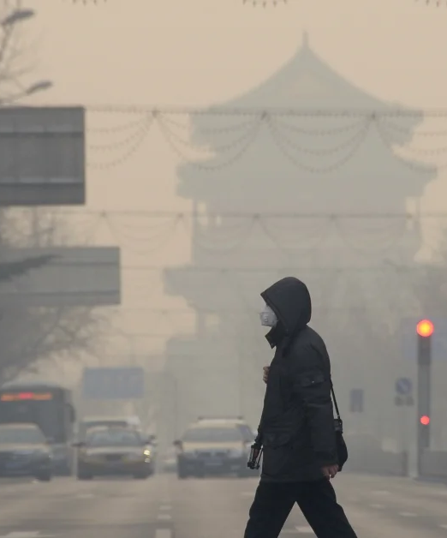
Data Description
This data set includes hourly air pollutants data from 12 nationally-controlled air-quality monitoring sites.
Beijing Municipal Environmental Monitoring Center, China Meteorological Administration.
Notes:
Ray

Slide 3
Roadmap | Executive Diagram
Victor Lu, Ray Ou Kairui
1st
2nd
3rd
4th
Data Processing
Model
Evaluation
Test
Import, extract data; Set labels and features; Split training and test.
Linear Regression model using neural networks as computational tool.
Comparing the loss between models.
Comparing prediction of the model to the actual data.
Notes:
Victor

Slide 4
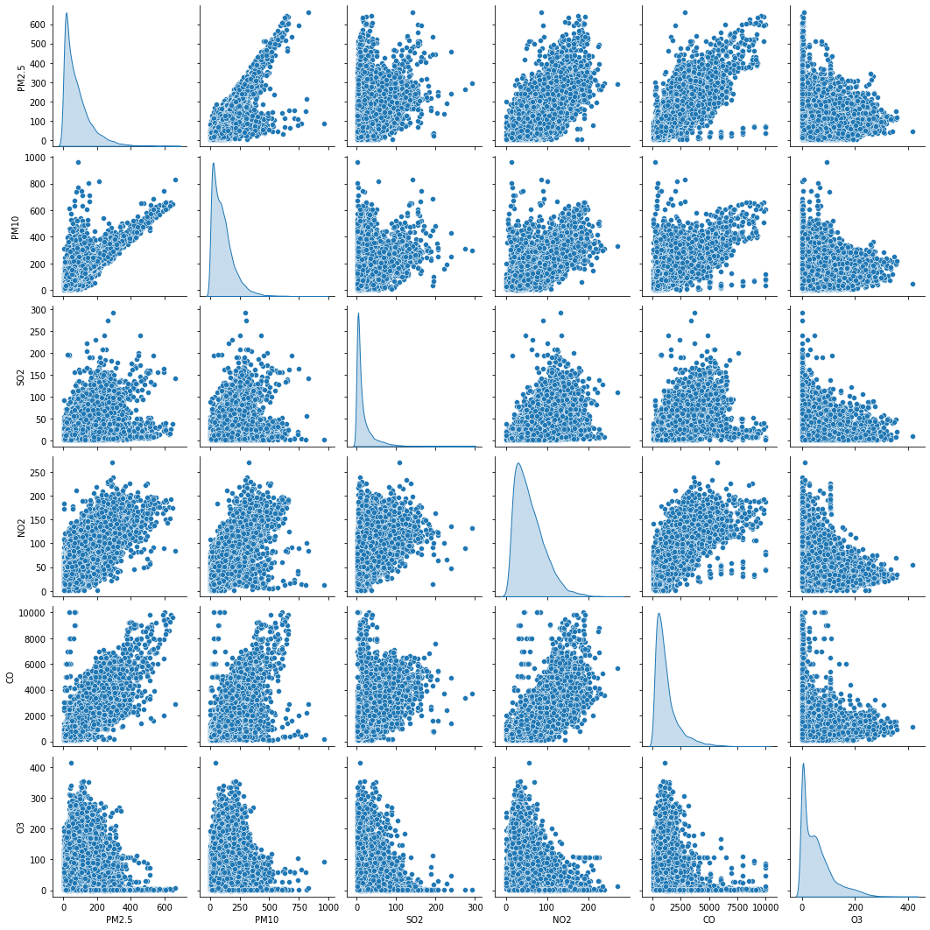
Pairplot: Data Visualization
Pairplot between the 6 main air pollutants concentrations:
PM2.5, PM10, SO2, NO2, CO, O3
Mostly positively related
Notes:
Ray

Slide 5
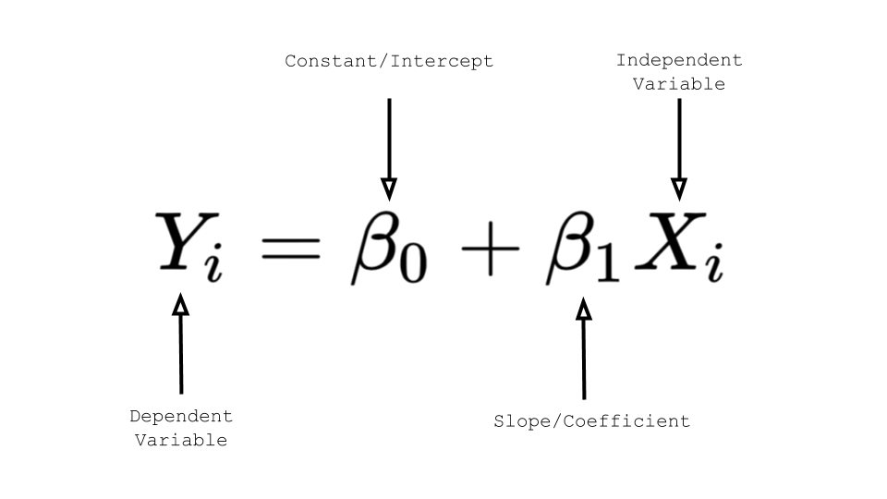
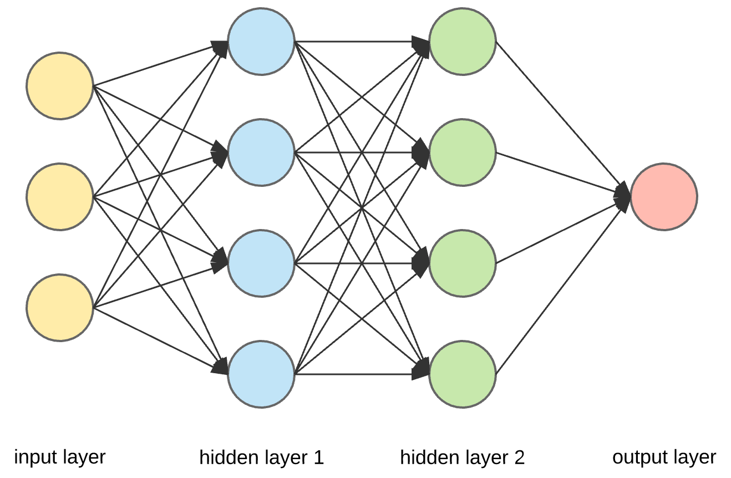
Model Construction
Victor Lu, Ray Ou Kairui
In this project we used a linear regression model by methods of constructing a neural network to compute the data.
Notes:
Victor

Slide 6
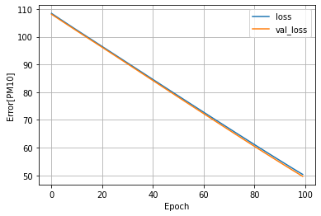
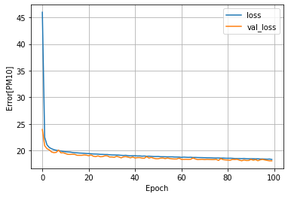
Performance
[1] Model with 1 layer of neurons
[2] Model with 3 layers of neurons
Victor Lu, Ray Ou Kairui
Notes:
Ray 1 layers (50)and 3 layers(10)

Slide 7
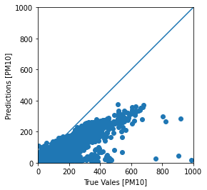
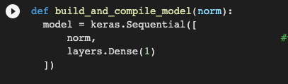
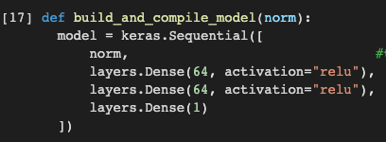
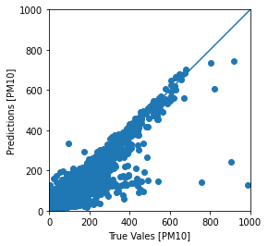
[3] Model with 1 layer of neurons
[5] 2 models for testing
[4] Model with 3 layers of neurons
In the [4] image, the prediction is more closely related with the actual data than in [3].
Victor Lu, Ray Ou Kairui
Notes:
Victor

Slide 8
Conclusions
Victor Lu, Ray Ou Kairui
The best model in our experiment performed 17.97 loss on the test set.
It is 63.8% lower than the baseline model which is 1-layer linear regression model.
The things we learned from this: 1. Fixing bug is a long process. 2. When the model is relatively simple, adding additional layers can make the model a lot of more accurate. 3. Judge the data carefully before using, importing it.
Notes:
上：Victor 下：Ray

Slide 9
Thanks For Watching!

